Slide 1
StructuralGT
Daisy Kiptoo
Graduate Student
Electrical and Computer Engineering
06/04/2025

Slide 2
An Overview
Graph Theory
StructuralGT
Applications
Summary

Slide 3
Graph Theory - Terms
A graph is just a way to show connections between entities.
It is comprised of 2 main components; edges and vertices (nodes):
  Vertices: These are the entities in the graph
  Edges: These are the connections between the entities in the graph

Slide 4
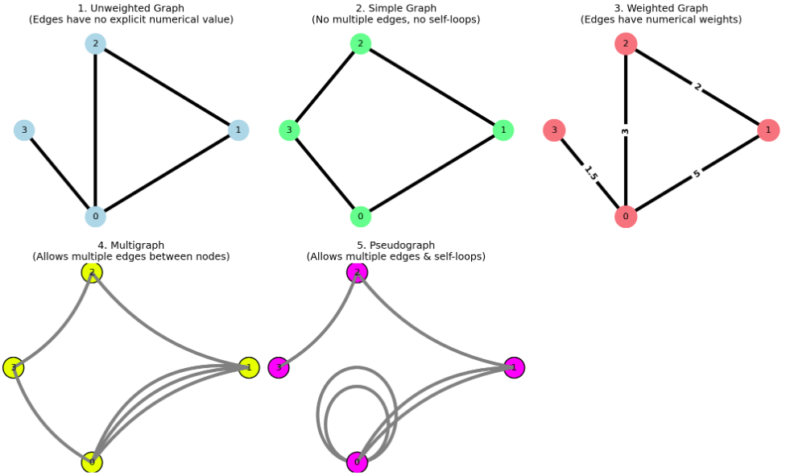
Graph Theory – Important Types of Graphs

Slide 5

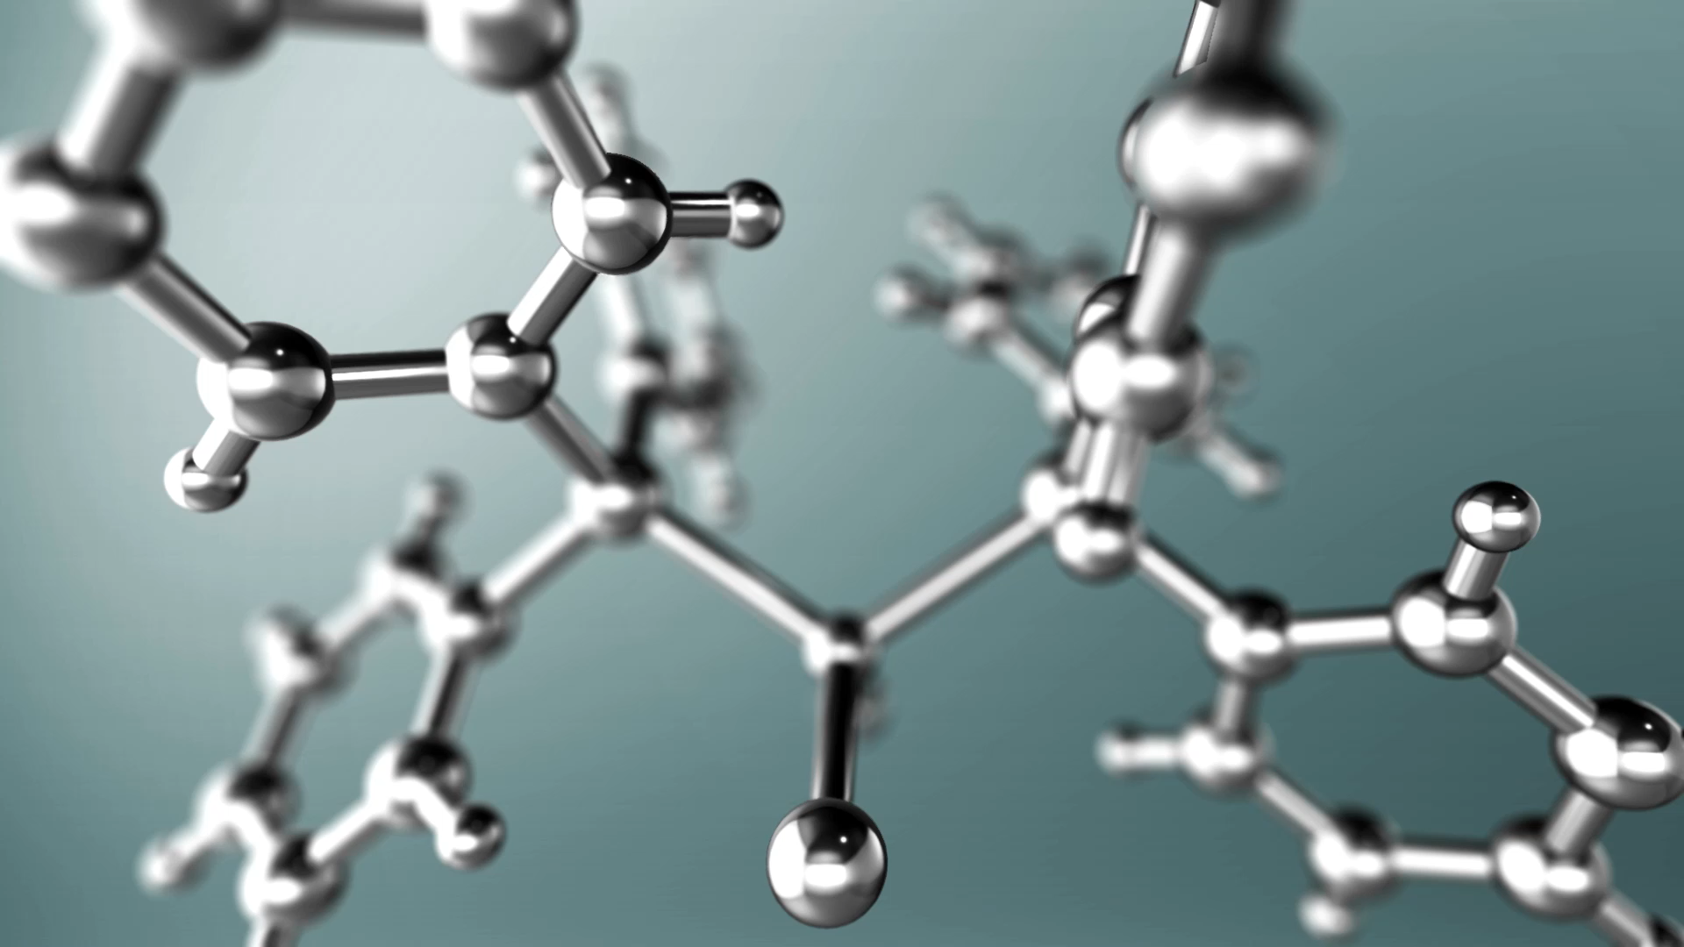

Graph Theory - Application

Slide 6
Graph Theory – Metrics

Slide 7
Graph Theory – Degree Centrality
What it measures: How many direct connections a node has.
Why it matters: Nodes with many neighbors can spread information (or forces, currents, etc.) more quickly.
1
2
3

Slide 8
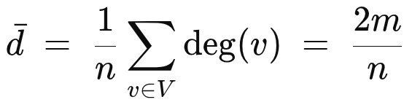
Graph Theory: Average Degree
What it measures: While the degree of a node shows how many direct connections a node has, the average degree summarizes the mean neighbors per node across the whole graph.
Why it matters: Nodes with many neighbors can spread information (or forces, currents, etc.) more quickly.
  n = nodes
  m = edges

Slide 9
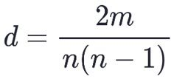
Graph Theory: Density
What it measures: This measures how “full” a graph is relative to the maximum number of edges it could have.
Why it matters: A low density means the graph is sparse (very few edges compared to the maximum), while a high density means the graph is nearly complete.
  n = nodes
  m = edges

Slide 10
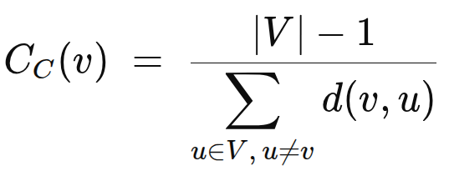
Graph Theory – Closeness Centrality
What it measures: How “near” a node is to all others, on average.
Why it matters: A node with high closeness can reach the rest of the network most efficiently; important for rapid communication or diffusion.

Slide 11
StructuralGT
Demo

Slide 12
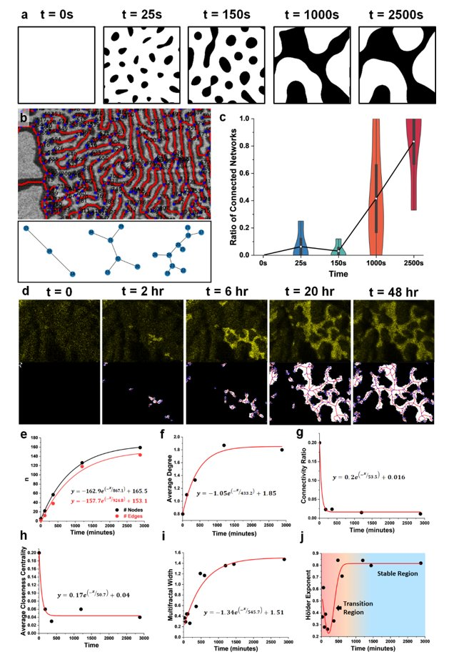

Slide 13
Graph Theory – Summary
Graph‐theoretic tools, from connectivity and centrality to clustering and curvature, offer a unified, quantitative framework for mapping all kinds of structures.

Slide 14
Thank You

