Slide 1







A Glimpse to Graph Theory and Network Science:
Computational Methods & Applications
2025 COMPASS Virtual Grand Challenge
Paul Bogdan
University of Southern California
Los Angeles, CA 90089 USA
(pbogdan@usc.edu)
June 2nd, 2025

Slide 2
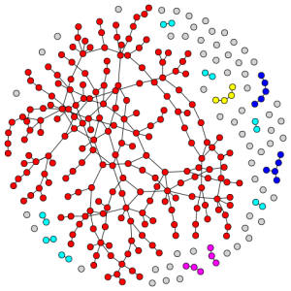
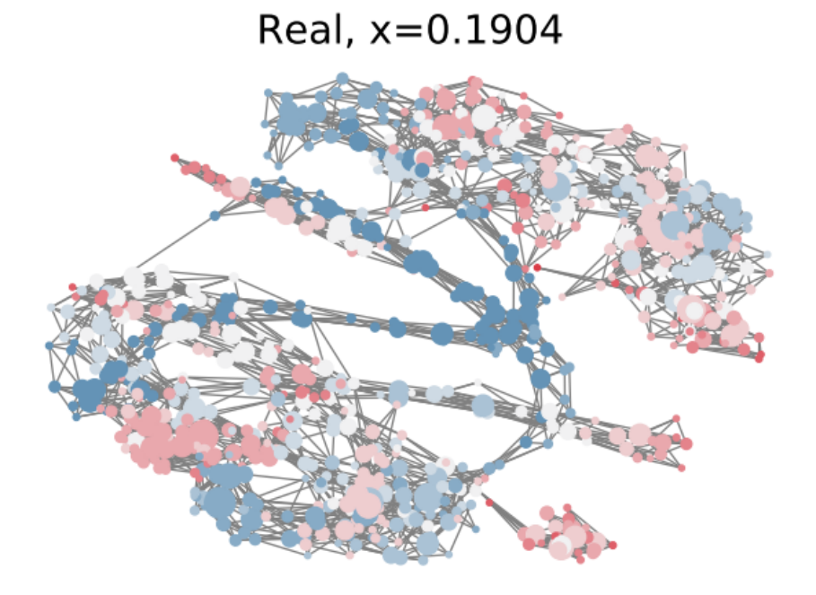
Overview
Graph theory vs. Network science
  Mathematical definitions
  Network science examples
  Node-level and path-level metrics
Applications
  Phase transitions in n-octyltrimethylammonium bromide (OTAB) in water
Multifractal network analysis
  Mathematical definitions
  Algorithms for multifractal network analysis
  Distance between graphs
  Applications

Slide 3
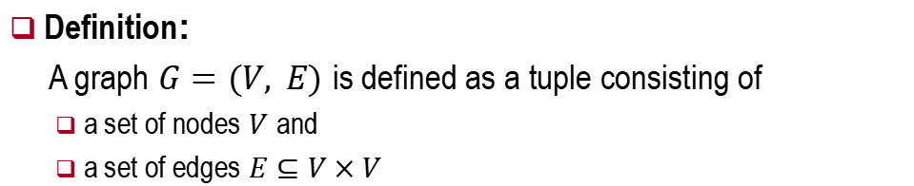
What is a Graph?
Definition:
A graph $G=(V, E)$ is defined as a tuple consisting of
  a set of nodes $V$ and
  a set of edges $E⊆V×V$
nodes
Types of graphs
Undirected
Directed
Unweighted
Weighted
Homogeneous
Heterogeneous
Labeled
Attributed
edges

Slide 4
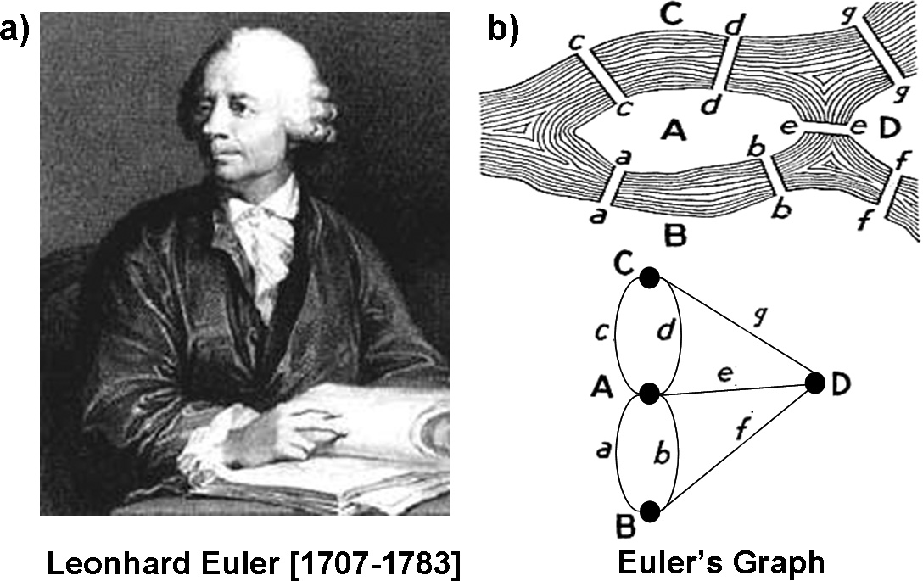
A Glimpse to History of Networks
(a) Leonhard Euler invented Graph Theory
  while trying to show that a path crossing all bridges in Konigsberg does not exist
(b) “Seven Bridges of Konigsberg” problem (1735)
  river sides are depicted as nodes and bridges as arcs

Slide 5
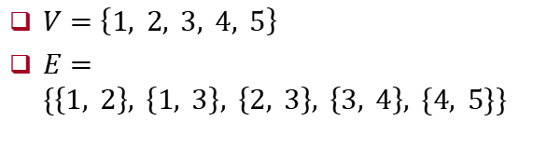
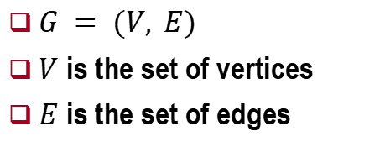
Undirected Graph
$G = (V, E)$
$V$ is the set of vertices
$E$ is the set of edges
1
2
3
5
4
$V=\left\{1, 2, 3, 4, 5\right\}$
$E=\{\left\{1, 2\right\}, \left\{1, 3\right\}, \left\{2, 3\right\}, \left\{3, 4\right\}, \{4, 5\}\}$

Slide 6
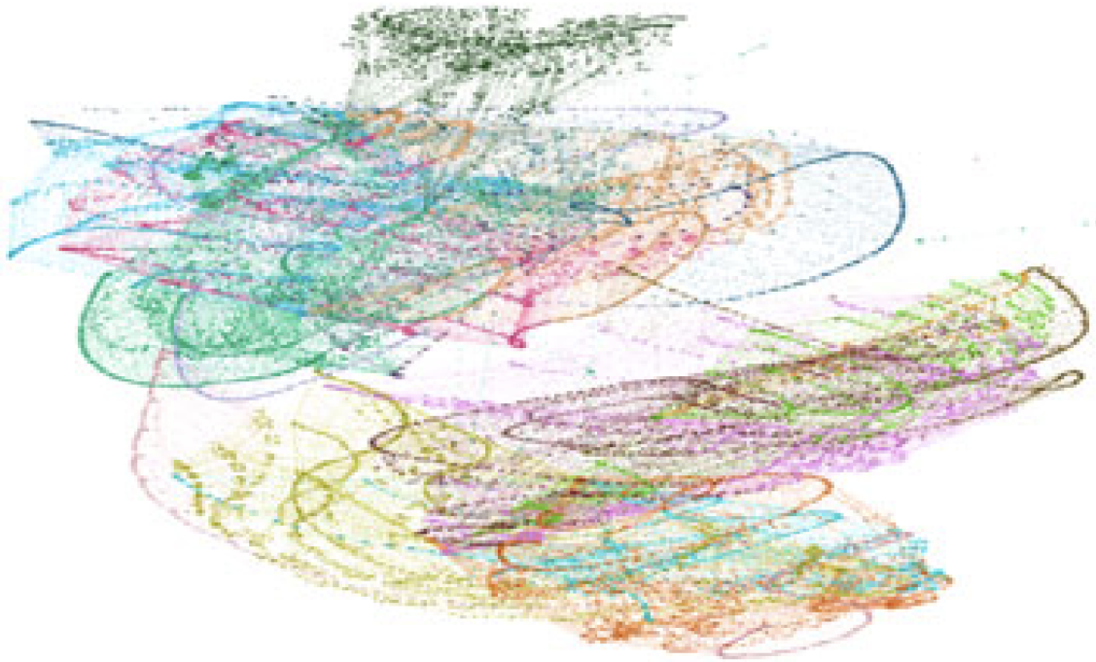
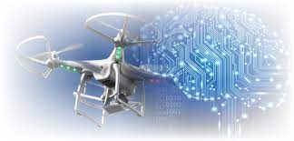
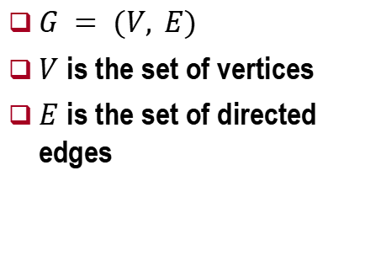

Directed Graph
$G = (V, E)$
$V$ is the set of vertices
$E$ is the set of directed edges
1
2
3
5
4
$V=\left\{1, 2, 3, 4, 5\right\}$
$E=\{\left(2, 1\right),\left(1, 3\right),\left(3, 2\right), (3, 4), (4, 5)\}$

Slide 7
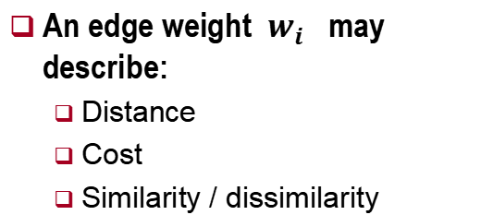
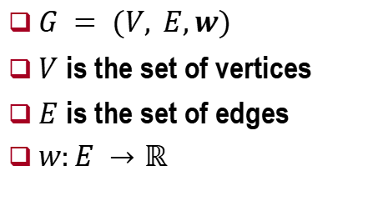
Weighted Graph
$G = (V, E,w)$
$V$ is the set of vertices
$E$ is the set of edges
$w:E →ℝ$
1
50
2
11
5
3
An edge weight $w_{i}$ may describe:
  Distance
  Cost
  Similarity / dissimilarity
0.25
5
-30
4

Slide 8
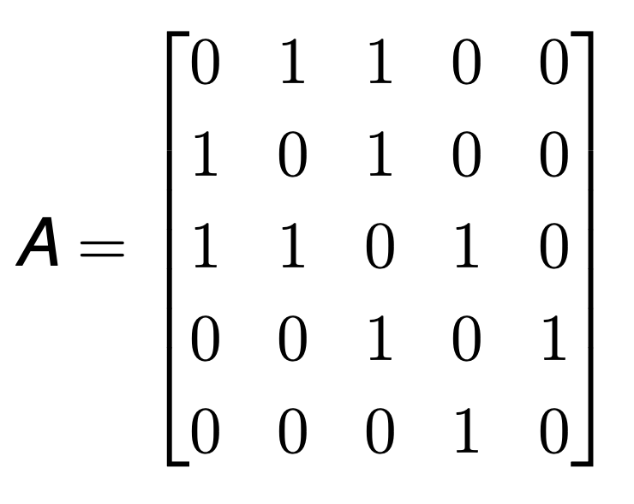
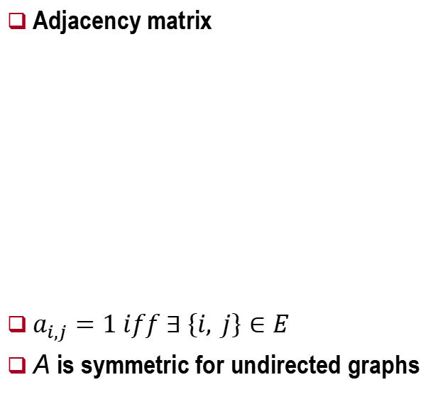
How do we describe mathematically Graphs?
Adjacency matrix
$a_{i,j}=1 iff ∃ \left\{i, j\right\}∈E$
A is symmetric for undirected graphs
1
2
3
5
4

Slide 9
Graph Theory vs. Network Science (NS)
A branch of complex systems science that uses mathematical tools and encodes the function(s) of a system through
  Patterns of interactions between components
  Dynamics of interaction patterns
  What are its tools?
    Graph theory, algorithms, statistical mechanics, system optimization /engineering
Complex systems science
Network biology
Network neuroscience
  Use of NS tools to understand the connectivity patterns in genes, neurons, organisms and social groups in humans and animals and their connectivity impact on behavior

Slide 10
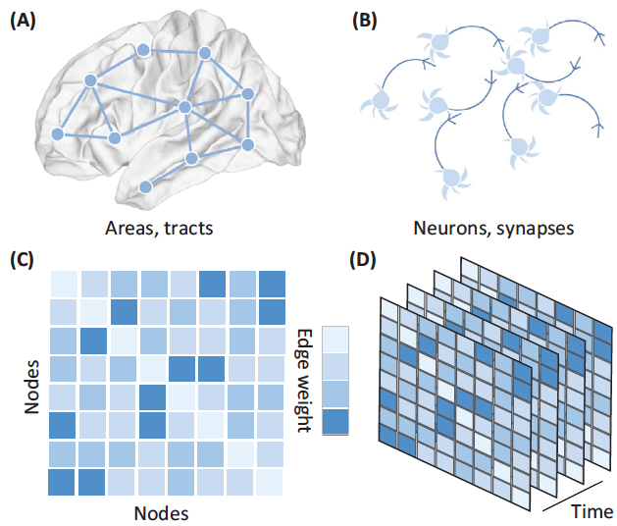
NS Representation of Brain
Neural systems represented as graphs across spatial scales
  Larger scales
    Brain regions denote network nodes
    Functional interactions between brain areas denoted as edges
  Smaller scales
    Neurons, glia and other cells can be represented as network nodes
    Gap junctions and chemical synapses represented as edges
  Mathematical tools
    Adjacency matrix encodes the connectivity information or a weight associated with each edge
    Nearest neighbor is the node with the highest weight
  Learning process in the brain is encoded into a sequence of connectivity patterns exhibited over a time horizon

Slide 11
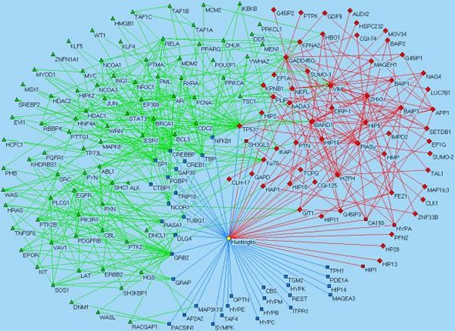
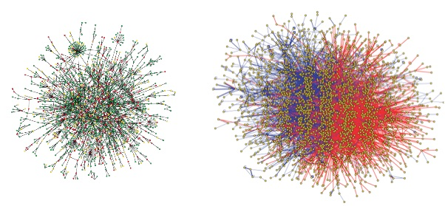
Protein-Protein Interaction Networks (PPINs)
Protein–protein interactions (PPIs)
  Physical contact between two or more molecule proteins governed by electrostatic forces
PPIN
  Graph-based representation of many PPIs
  Edges in this graph represent specific physical contacts between proteins, taking place at specific locations on proteins, and having a specific biological function
Examples
  PPIN in Huntington's disease
Interactome
  All PPIs that happen in a cell, an organism or a specific biological context
https://www.mdc-berlin.de/10221541/en/research/research_teams/proteomics_and_molecular_mechanisms_of_neurodegenerative_diseases/research/research1
Yeast (left) and human (right) interactomes obtained using the yeast-two hybrid method (Jeong et al. Nature 2001. 411 (3) and Rual et al. Nature 2005: 437 (4))
https://www.ebi.ac.uk/training/online/course/network-analysis-protein-interaction-data-introduction/protein-protein-interaction-networks

Slide 12
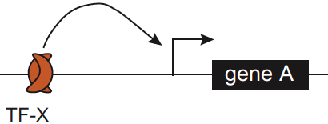
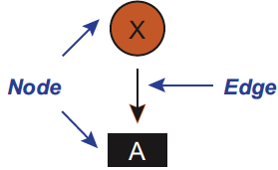
Graph Theory - Basics in Networks (I)
A graph is a mathematical object consisting of
  Nodes (transcription factors (TFs) + target genes: TF-X + gene A) and
  Edges (physical or regulatory relationships between the transcription factors & their target genes)
  Gene regulatory networks (GRN) are
    Bipartite graphs = consists of two types of nodes like the TFs and their target genes
    Directed graphs = edges indicate a relationship from a TF to a target gene or a cis-regulatory elements (CRE) located in the genome
    Edge types
      Direct physical interactions between TFs and DNA elements
      Logical relationship or regulatory interaction representing which genes are positively / negatively influenced by loss / overexpression of a TF
A.J.M. Walhout, M. Vidal, and J. Dekker, Handbook of Systems Biology: Concepts and Insights, Academic Press, December 2012

Slide 13
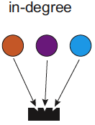
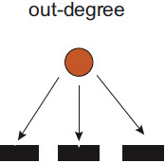
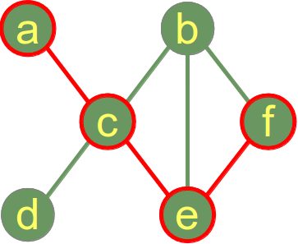
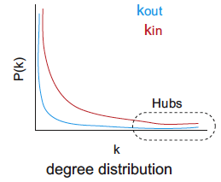
Graph Theory - Basics in Networks (II a)
IN / OUT degree
  Number of incoming / outgoing edges into / from a node
  OUT degree is defined by the number of genes bound or regulated by a particular TF
  IN degree is the number of TFs that bind or regulate a certain gene
Distance d
  Number of edges along the shortest path between two nodes
Network (graph) diameter
  Maximum value over the entire existing distances
Degree distribution
  Fraction of the nodes from the entire network nodes having IN / OUT degree k
A.J.M. Walhout, M. Vidal, and J. Dekker, Handbook of Systems Biology: Concepts and Insights, Academic Press, December 2012

Slide 14
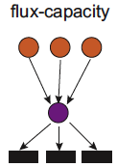
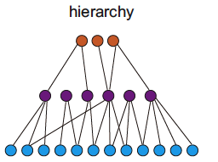
Graph Theory - Basics in Networks (II b)
Flux-capacity
  Product of IN and OUT degrees represents the flux-capacity
  Indicates the number of information paths passing directly through a node
  High flux-capacity indicates the importance of a node to network functionality
Flux-capacity in purely transcriptional gene regulatory networks implies a hierarchical structure
  Different layers of TFs regulating one another
  TFs act as both upstream regulators and downstream targets

Slide 15



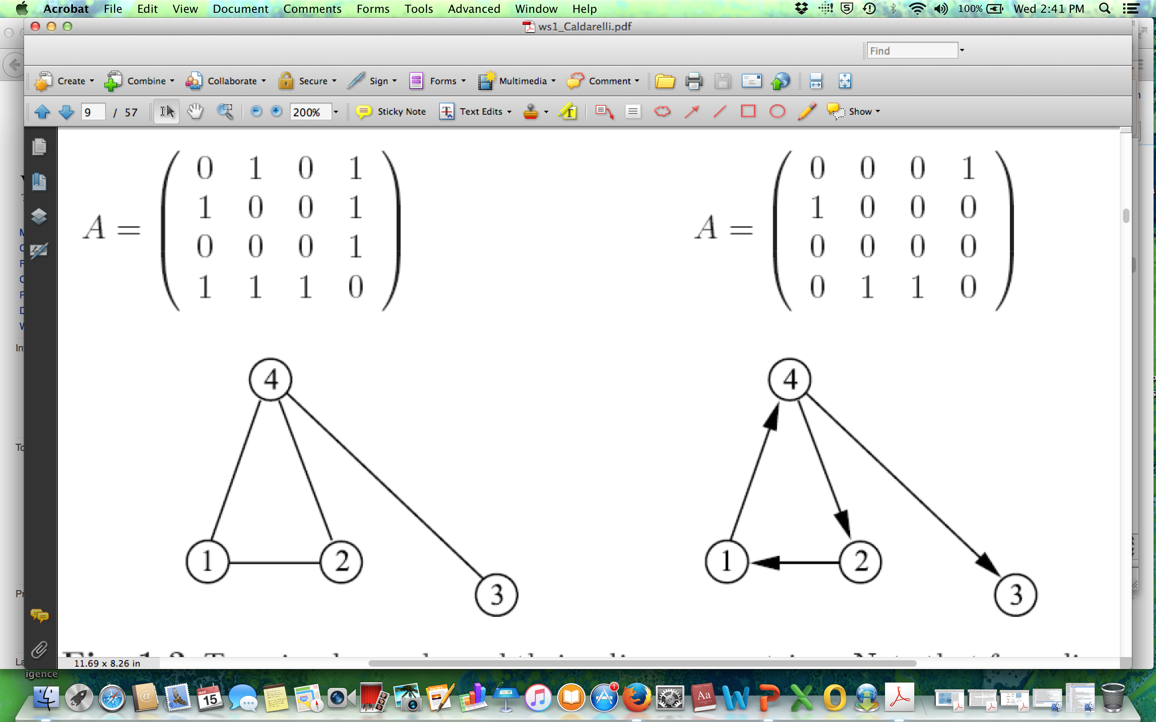

Graph Theory – Adjacency Matrix (III)
A matrix where
  Each raw or column represents a node
  Each element represents where there is an edge and with what weight

Slide 16
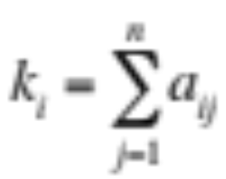
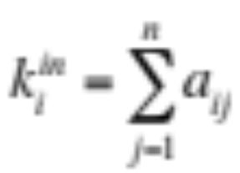
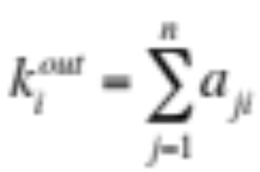
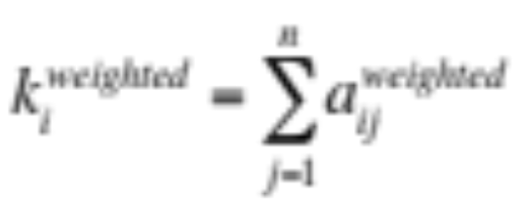
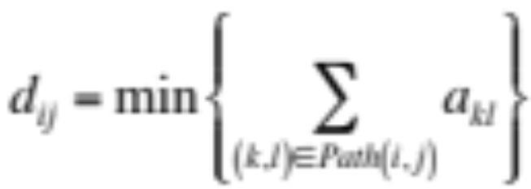
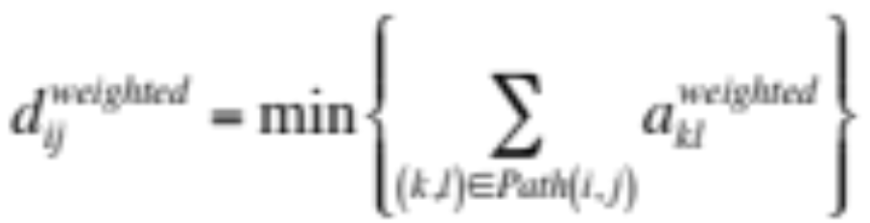
Graph Theory – Adjacency Matrix (IV)
Define normal (total) / IN / OUT / weighted degree through the adjacency matrix
Distance for unweighted and weighted adjacency matrices
  Observation: based on the studied problem, one can define other notions of distance like the inverse of weights or any nonlinear function of the encountered weights on the edges

Slide 17
Degree Centrality
Quantify the importance or influence of a node within a graph based on the number of its edges
In directed graphs:
  In-degree centrality
  Out-degree centrality
2
3
3
2
1
2
5

Slide 18
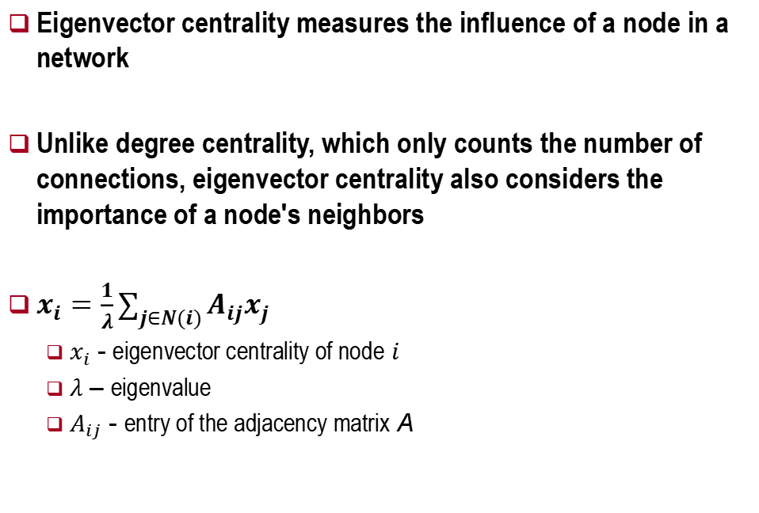
Eigenvector Centrality
Eigenvector centrality measures the influence of a node in a network
Unlike degree centrality, which only counts the number of connections, eigenvector centrality also considers the importance of a node's neighbors
$x_{i}=\frac{1}{λ}\sum_{j∈N(i)}{A_{ij}x_{j}}$
  $x_{i}$ - eigenvector centrality of node $i$
  $λ$ – eigenvalue
  $A_{ij}$ - entry of the adjacency matrix A

Slide 19
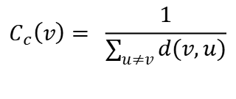
Closeness Centrality
A measure of centrality of a node in a network
Shortest paths between the node and all other nodes
The more central a node is, the closer it is to all other nodes
$$C_{c}\left(v\right)= \frac{1}{\sum_{u≠v}{d(v,u)}}$$
2
1
1
1
2
0

Slide 20
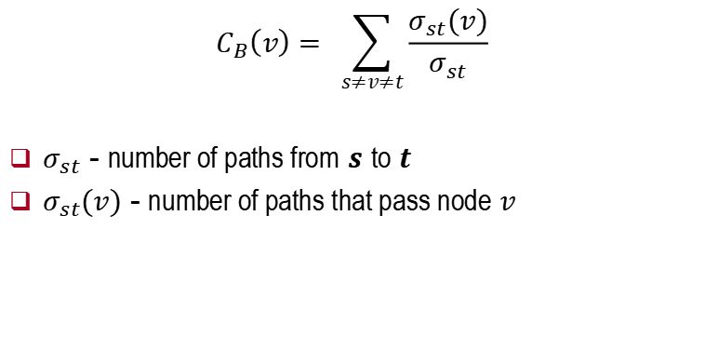
Betweenness Centrality
Measures the extent to which a node lies on the shortest paths between other nodes in the network
Shortest path involvement
$$C_{B}\left(v\right)= \sum_{s≠v≠t}{\frac{σ_{st}(v)}{σ_{st}}}$$
$σ_{st}$ - number of paths from $s$ to $t$
$σ_{st}(v)$ - number of paths that pass node $v$

Slide 21
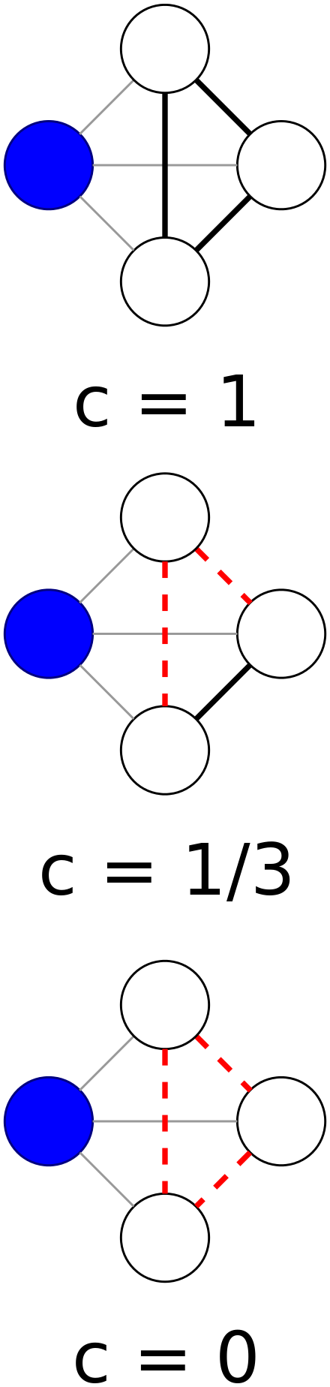

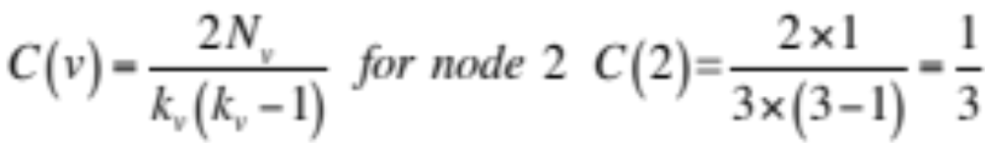
Clustering
1) global clustering coefficient for a graph can be computed
    A triangle consists of three nodes that are completely connected to each other by three edges (an incomplete triangle will not be counted)
    A triple represents three nodes i, j and k where i is connect to j and j is connect to k
    Factor 3 appears in the numerator due to symmetry, because counting from the perspective of each node of the complete triangle, a triangle is counted three times
2) Compute local clustering coefficient for each node
and then average across all nodes
N_{v} – number of links between neighbors of v
k_{v} – number of links attached to node v

Slide 22
Overview
Graph theory vs. Network science
  Mathematical definitions
  Network science examples
  Node-level metrics
Applications
  Phase transitions in n-octyltrimethylammonium bromide (OTAB) in water
Multifractal network analysis
  Mathematical definitions
  Algorithms for multifractal network analysis
  Distance between graphs
  Applications

Slide 23
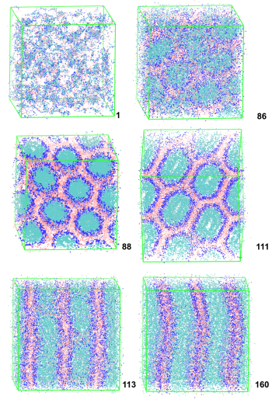
Quantifying Phase Transitions
Structural changes and fluctuations are difficult to quantify for phases with high asymmetry and multiscale organization
  Long-range graph theory descriptors provide characterization of phase transitions in water / surfactant systems
Molecular dynamic simulation
  Binary solutions of n-octyltrimethylammonium bromide (OTAB) in water
Phase diagrams
    Spheroidal micelles (isotropic phase) → cylinders (hexagonal phase): x = 0.204
    Cylinders (hexagonal phase) → lamellae (lamellar phase): x = 0.431
x=0.007
x=0.190
x=0.204
x=0.409
x=0.431
x=0.930
micelles → cylinders
cylinders → lamellae

Slide 24
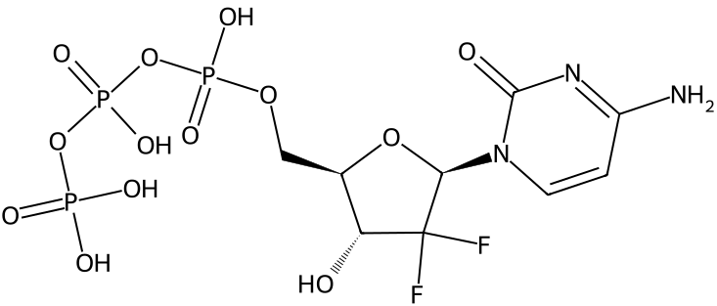
n-Octyl Trimethyl Ammonium Bromide in H₂O
n-octyltrimethylammonium bromide (OTAB) in water has amphiphilic properties
  water-loving (hydrophilic)
  water-repelling (hydrophobic)
Applications
  Biotechnology: antimicrobial, gene delivery, (cell) membrane regulation
  Material science: synthesis of nanoparticle, engineering functional materials, assembly of nanostructures
  Environmental science: soil and water pollution remediation, microplastics
x=0.007
x=0.190
x=0.204
x=0.409
x=0.431
x=0.930
micelles → cylinders
cylinders → lamellae

Slide 25
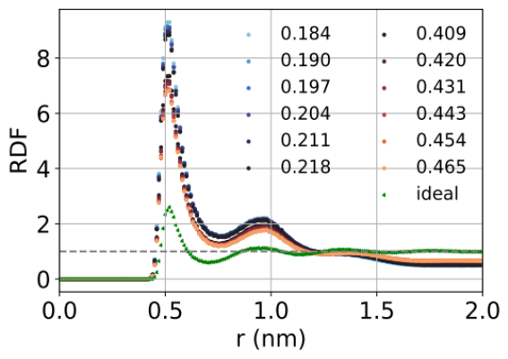
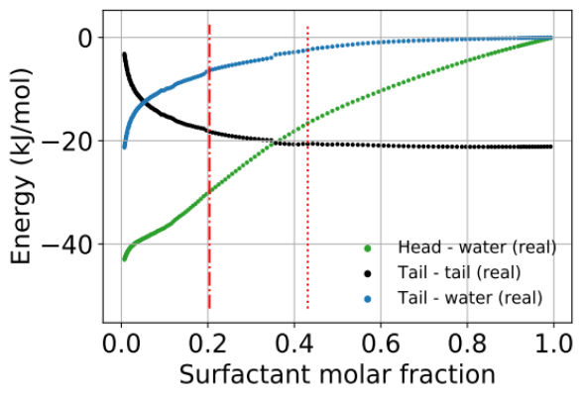
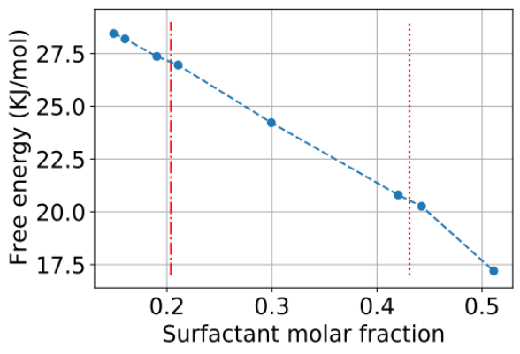
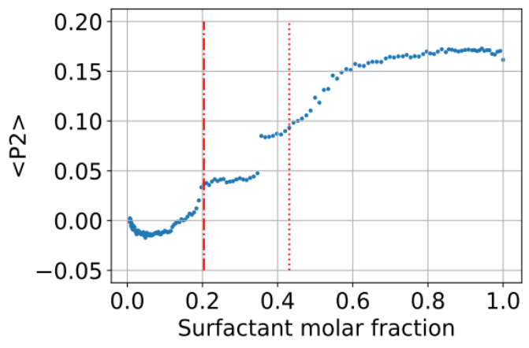
Molecular Dynamics Descriptors
No discontinuity / inflection detected near phase transitions
    Left: radial distribution function (RDF) for terminal tail beads
    Middle: potential energy of tail-tail, tail-water, and head-water interactions
    Right: free energy changes between real and ideal solutions
Average P₂ order parameter exhibits plateaus for two phases
  Highest gradient in P₂ at x = 0.357 is supposed to indicate a phase transition
    Sensitive to changes in the shape of micelles from circular to cylindrical taking place for x between 0.2 and 0.4 than to their packing

Slide 26
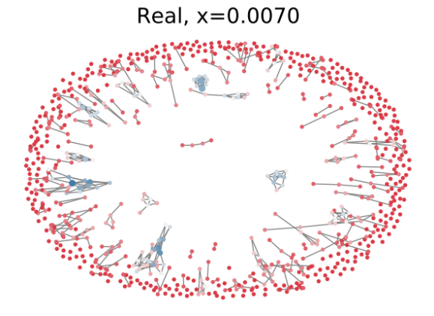
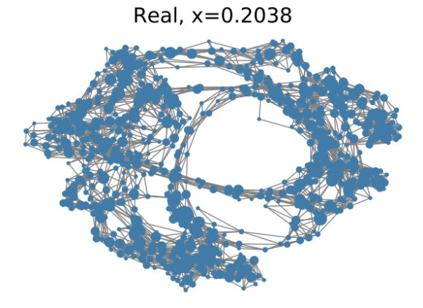
Graph Description of Complex Systems
Graph representation
  Node = surfactant
  Assign edge with a Euclidean distance between pair tails smaller than 0.7nm
Local / short-term measurement
  Degree centrality
  Clustering coefficient
Global / long-term measurement
  Closeness centrality
  Betweenness centrality
  Node-based fractal dimension (NFD)
    Measures self-similarity of a graph by calculating the spatial dimension of the expansion from a certain node based on box-growing method

Slide 27
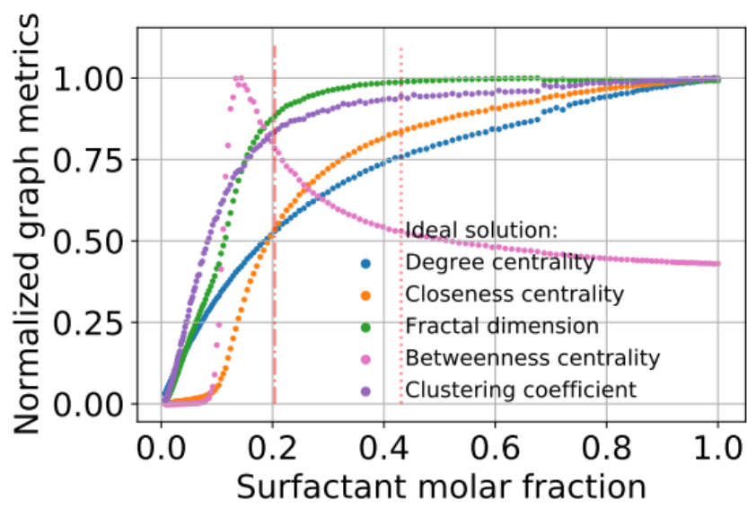
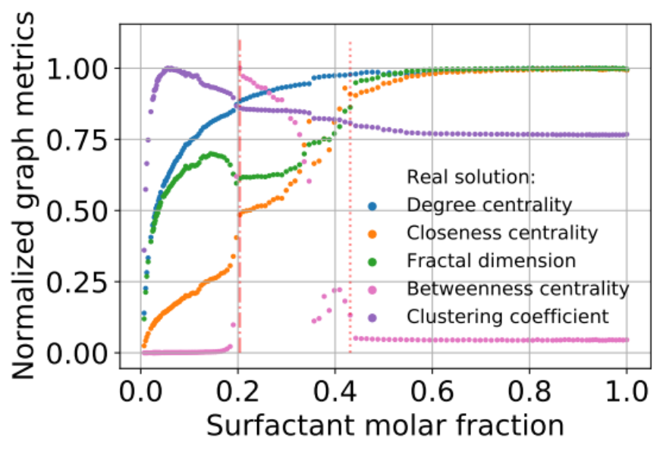
GT Shades Light on Phases
Phase transition from micellar to hexagonal phase at x = 0.204 is associated with sharp changes in
  Closeness centrality (CC)
  Betweenness centrality (BC)
  Node-based fractal dimension (NFD)
Phase transition from hexagonal to lamellar phase at x = 0.431 exhibits a plateau in terms of CC, BC and NFD

Slide 28
Network Science Tools
Pajek
  Network visualization tool allowing to interactively manipulate the network
Graphviz
  A simple network visualization tool available for a variety of platforms.
Gephi
GUESS
  An exploratory data analysis and visualization tool
JUNG
  A Java Universal Network/Graph Framework
UCINET
  Social network visualization & analysis tool
SNAP
  Stanford Network Analysis Platform
NetLogo
  A multi-agent programmable modeling environment
iGraph
  Software for creating & manipulating undirected and directed graphs
NetworkX
  Python package for studying the structure, dynamics, & functions of complex networks
IVC
  InfoVis Cyberinfrastructure is a collection of data analysis and visualization algorithms
Net
  A program for the creation and statistical analysis of large networks
graph-tool
  Python module for statistical analysis

Slide 29
Overview
Graph theory vs. Network science
  Mathematical definitions
  Network science examples
  Node-level metrics
Applications
  Phase transitions in n-octyltrimethylammonium bromide (OTAB) in water
Multifractal network analysis
  Mathematical definitions
  Algorithms for multifractal network analysis
  Distance between graphs
  Applications

Slide 30
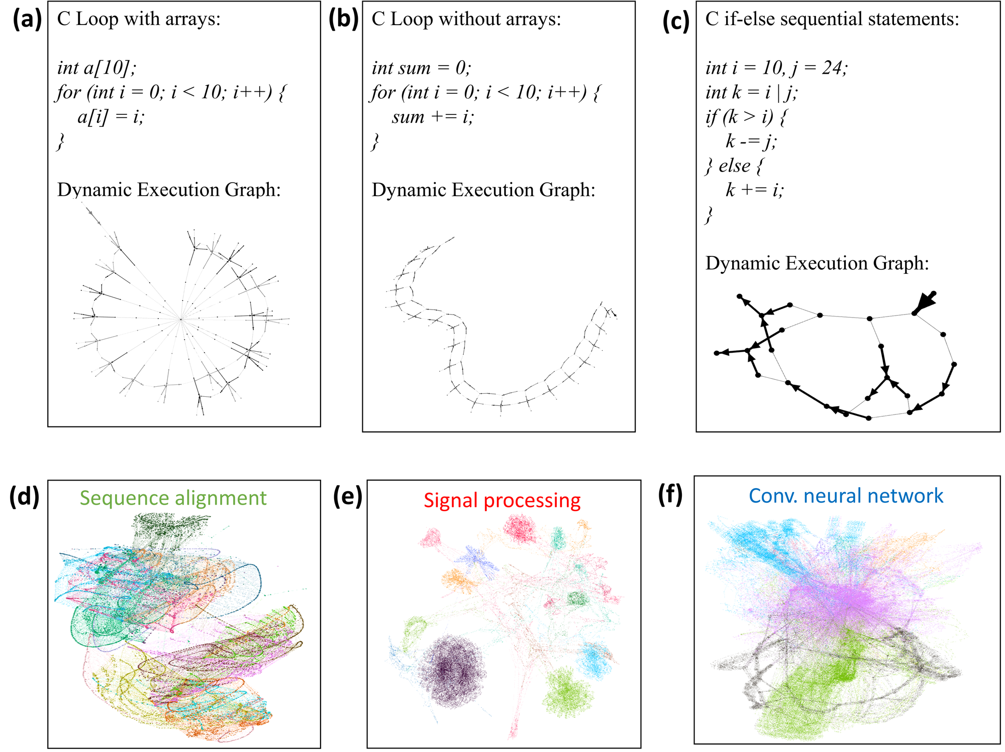
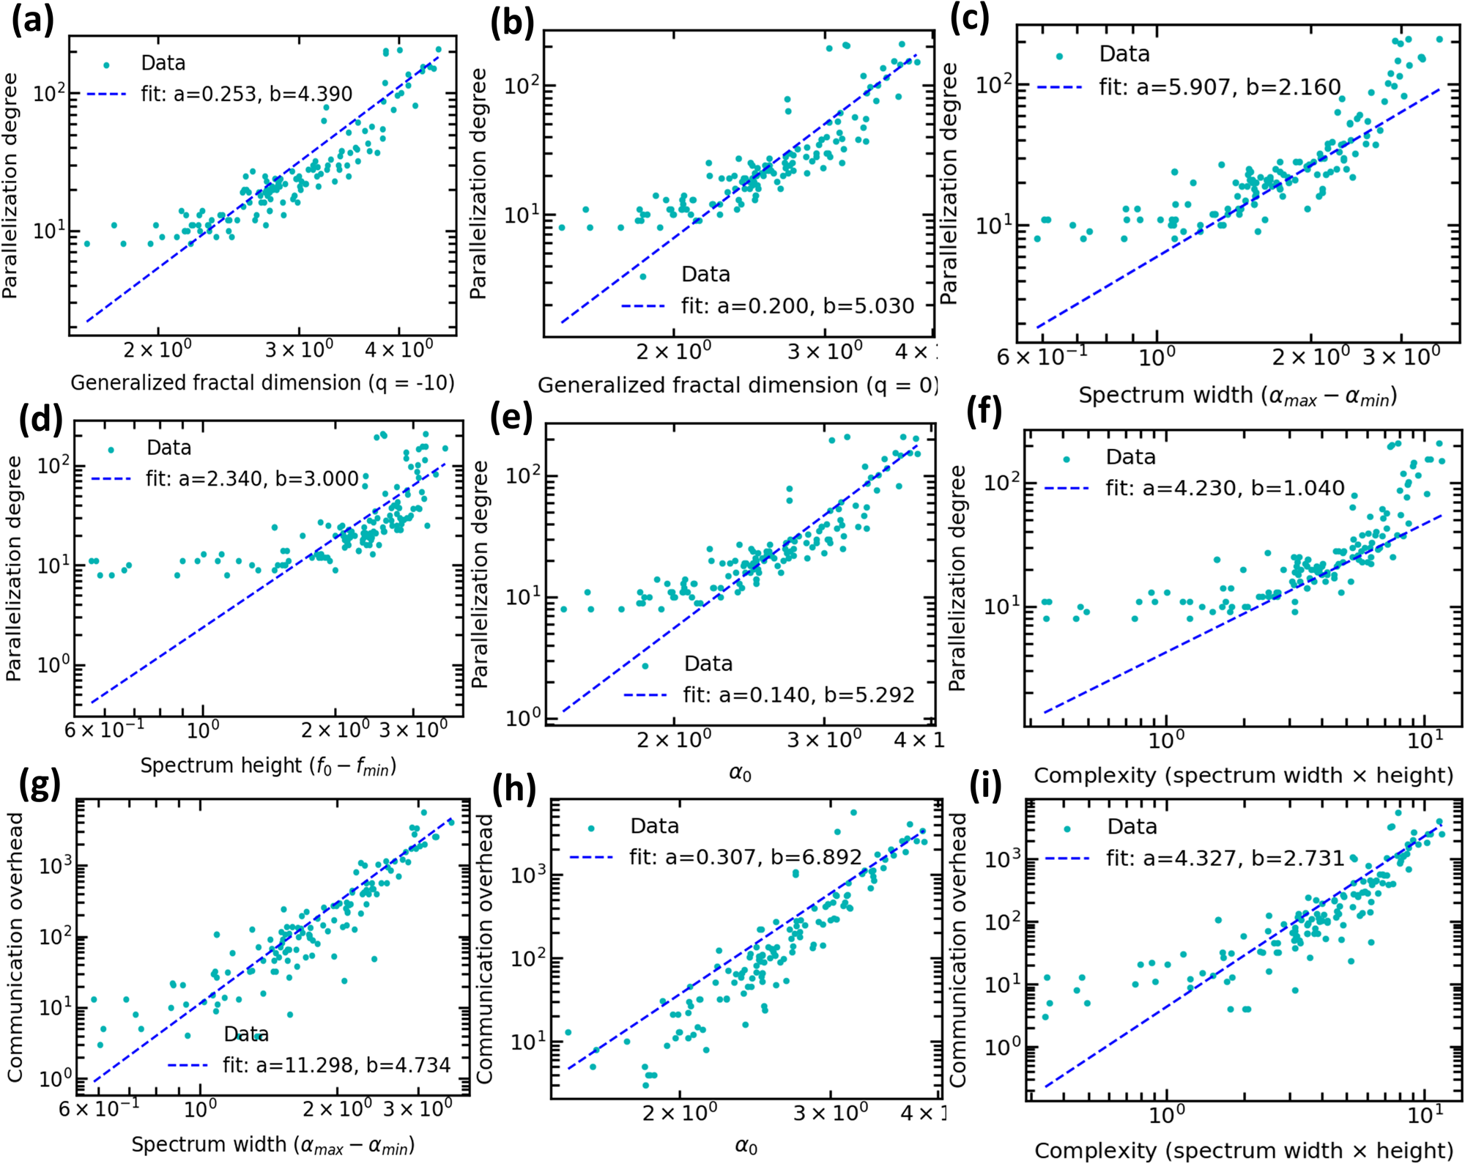
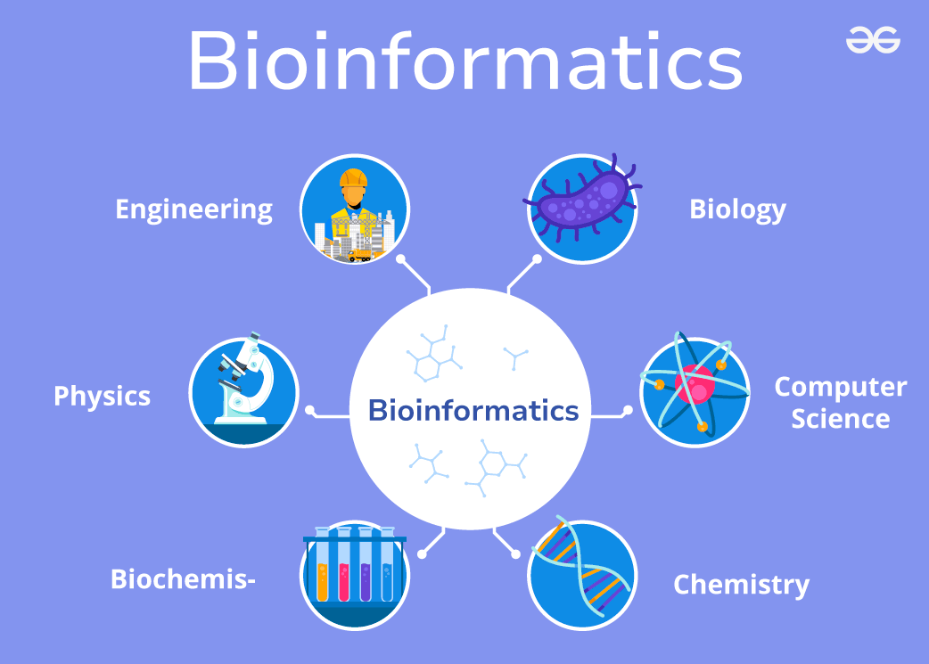
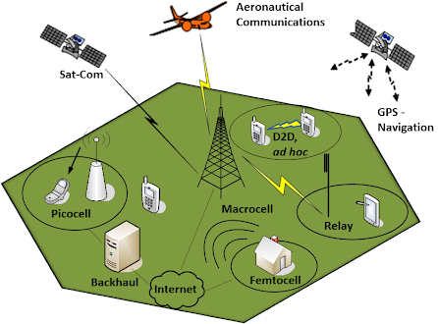

Networks appear irregular, are they?
Xiao, Yao, Guixiang Ma, Nesreen K. Ahmed, Mihai Capotă,
Theodore L. Willke, Shahin Nazarian, and Paul Bogdan. "End-to-end programmable computing systems." Communications Engineering 2, no. 1 (2023): 84.

Slide 31



Fractal Analysis (I)
Fractal Analysis
  Fractal analysis began in the 19th century and was developed by Benoît B. Mandelbrot in the 20th century to describe complex, self-similar structures in nature
  “Self-similar," meaning that each portion can be considered a reduced-scale image of the whole [1]
  What is the fractal dimension of the coastline?
[1] Mandelbrot, Benoit. "How long is the coast of Britain? Statistical self-similarity and fractional dimension." science 156.3775 (1967): 636-638.
Notes:
Fractal analysis originated in the 19th century with the study of irregular geometric shapes by mathematicians like Georg Cantor and Felix Hausdorff, who introduced concepts such as the Cantor set and Hausdorff dimension. It was later systematically developed by Benoît B. Mandelbrot in the 20th century, who coined the term "fractal" and used it to describe and analyze complex, self-similar structures in nature, such as coastlines, clouds, and mountains. Mandelbrot’s work unified earlier ideas and expanded fractal geometry into a broad field with applications across physics, biology, and finance.

Slide 32


Fractal Analysis (II)
Fractal Dimension (FD) of Coastline
  FD of a coastline is calculated by measuring its length at various scales and applying the power law relationship between scale and length to determine the fractal dimension
A FD of 1.25 for the British coastline reflects its complexity, being more intricate than a line but not fully occupying a plane.
[1] Mandelbrot, Benoit. "How long is the coast of Britain? Statistical self-similarity and fractional dimension." science 156.3775 (1967): 636-638.
Notes:
Fractal analysis originated in the 19th century with the study of irregular geometric shapes by mathematicians like Georg Cantor and Felix Hausdorff, who introduced concepts such as the Cantor set and Hausdorff dimension. It was later systematically developed by Benoît B. Mandelbrot in the 20th century, who coined the term "fractal" and used it to describe and analyze complex, self-similar structures in nature, such as coastlines, clouds, and mountains. Mandelbrot’s work unified earlier ideas and expanded fractal geometry into a broad field with applications across physics, biology, and finance.

Slide 33




Fractal Analysis (III)
Box-counting method
  Partition the data set with minimal number N (r) of boxes of size r
  Fractal dimension d is determined by
  Fractal: power-law scaling dependence
d = 1.719

Slide 34
A Simple Example
0.2
0.2
0.2
0.2
0.05
0.05
0.05
0.05
0.05
0.05
0.05
0.05
0.3
0.3
0.3
0.1
5
5
4
4
3
3
2
2
1
1
0.1
0.2
0.3
0.4
0.5
0.1
0.2
0.3
0.4
0.5

Slide 35




Node-based Fractal Dimension (I)
NFD captures the power-law relationship between the number of nodes in the box and the box radius
NFD represents the generating rule of the network with a certain node as the origin of the network
High NFD
Approximate the slope
Low NFD
$${NFD}_{i} \sim \frac{\ln\left(\frac{M\left(r\right)}{M\left(r_{0}\right)}\right)}{\ln\left(\frac{r}{r_{0}}\right)}$$
$$\frac{M(r)}{M(r_{0})}\sim {\left(\frac{r}{r_{0}}\right)}^{{NFD}_{i}}$$
$$\frac{9}{5}\sim {\left(\frac{2}{1}\right)}^{NFD}$$
$r_{i}$ : Radius of a box that covers (i-1)^{th} layer
$M(r_{i})$ : Number of nods within the (i-1)^{th} layer

Slide 36

Node-based Fractal Dimension (II)
Exemplification of calculating the node-based fractal dimension

Slide 37





Node-based Multifractal Analysis (I)
Main concepts of NMFA method
  Graph with multiple
  generating rules
  Assign a probability measure
  Introduce a distortion factor q to capture topological differences and define a topological partition function
Multi-fractal scaling behavior
q<0: Prioritize rare patterns
$$u_{i}\left(r\right)= \frac{M_{i}(r)}{M}$$
( M is the total number of nodes in the network, $r$ is the box radius)
q>0: Prioritize abundant patterns
$$U_{q}\left(r\right)= \sum_{i=1}^{M}{{μ_{i}\left(r\right)}^{q}}$$
$U_{q}\left(r\right)\sim r^{τ(q)}$
, where $τ(q)$ is the mass exponent
[1] Xiao, Xiongye, Hanlong Chen, and Paul Bogdan. "Deciphering the generating rules and functionalities of complex networks." Scientific reports 11.1 (2021)

Slide 38

Node-based Multifractal Analysis (II)
Multifractal Spectrum
Mass Exponent: $τ\left(q\right)=\lim_{l/L→0}{\frac{log\sum_{i=1}^{n}{{(\frac{M_{i}(r)}{M})}^{q}}}{log⁡(\frac{r}{d})}}$
Lipschitz$−Holder Exponent:α\left(q\right)=\frac{dτ\left(q\right)}{dq}=\lim_{l/L→0}{\frac{\sum_{i=1}^{n}{{[(\frac{M_{i}(r)}{M})}^{q}log⁡(\frac{M_{i}\left(r\right)}{M})]}}{log⁡(\frac{r}{d})\sum_{i=1}^{n}{{(\frac{M_{i}(r)}{M})}^{q}}}}$
Multi-fractal Spectrum
$U_{q}\left(r/d\right)$vs r/d
𝜏(𝑞) vs 𝑞
Legendre transform
$$U_{q}\left(r\right)\sim r^{τ(q)}$$
$$\left.f\left(α\right)=qα\left(q\right)−τ(q\right)$$
[1] Xiao, Xiongye, Hanlong Chen, and Paul Bogdan. "Deciphering the generating rules and functionalities of complex networks." Scientific reports 11.1 (2021)

Slide 39

Node-based Multifractal Analysis (III)
Multifractal Spectrum
Intersection $f(α)$ can have 0 to negative values at a range [-q,q]. Therefore, the NMFA provides important information of different fractal dimension emphasized by q, distortion factor, and gives frequency of those fractal degree within the network
$$τ\left(q\right)$$
$$−f(α)$$
Slope: $α$
$$q$$
Multi-fractal Spectrum
$U_{q}\left(r/d\right)$vs r/d
𝜏(𝑞) vs 𝑞
Legendre transform
$$U_{q}\left(r\right)\sim r^{τ(q)}$$
$$\left.f\left(α\right)=qα\left(q\right)−τ(q\right)$$
[1] Xiao, Xiongye, Hanlong Chen, and Paul Bogdan. "Deciphering the generating rules and functionalities of complex networks." Scientific reports 11.1 (2021)

Slide 40



Node-based Multifractal Analysis (IV)
Multifractal spectrum
  Width of multifractal spectrum represents the heterogeneity of a network
    The wider the spectrum, the more heterogeneous the network is
  Lipschitz-Holder exponent 𝛼 characterizes the density and complexity of the network
    The larger 𝛼, the higher the network spatial complexity
$U_{q}$ = ($\frac{1}{20}$)²⁰ + ($\frac{18}{20}$)²⁰ + ($\frac{2}{20}$)²⁰ + $⋯$
Different q value emphasizes different mass distributions in boxes, thus distinguish the fractal properties based on different nodes
i = 1 2 3
$U_{q}$ = ($\frac{1}{20}$)⁻²⁰ + ($\frac{18}{20}$)⁻²⁰ + ($\frac{2}{20}$)⁻²⁰ + $⋯$
i = 1 2 3
[1] Xiao, Xiongye, Hanlong Chen, and Paul Bogdan. "Deciphering the generating rules and functionalities of complex networks." Scientific reports 11.1 (2021)

Slide 41


A Simple Example
Capture the dynamics of the network
  Multifractal analysis captures structural variations within a network
  Edge addition increases the graph complexity & heterogeneity as the multifractal spectrums become wider and Lipschitz-Holder exponent moves to higher values
  ($α_{max}−α_{min}$), and $α_{0}(\text{when} f\left(α\right)$ is at its maximum) quantify the complexity and heterogeneity of complex networks
Original network
Build more connections
Become more complex
G0
G1
G2
[1] Xiao, Xiongye, Hanlong Chen, and Paul Bogdan. "Deciphering the generating rules and functionalities of complex networks." Scientific reports 11.1 (2021)

Slide 42



Structural Distance Analysis
Generalized Fractal Dimension
$$τ\left(q\right)=\lim_{l/L→0}{\frac{log\sum_{i=1}^{n}{{(\frac{M_{i}(r)}{M})}^{q}}}{log⁡(\frac{r}{d})}}$$
$$D\left(q\right)=\frac{τ(q)}{q}$$
Structural Distance
  Between two networks is calculated by comparing the difference in their generalized fractal dimensions 𝐷(𝑞) across a range of 𝑞 values, quantifying the topological dissimilarity based on how their dimensions diverge under varying distortion exponents
[1] Xiao, Xiongye, Hanlong Chen, and Paul Bogdan. "Deciphering the generating rules and functionalities of complex networks." Scientific reports 11.1 (2021)

Slide 43


Spectral Distance
Measures the difference between two networks by comparing the eigenvalue spectra of their adjacency or Laplacian matrices
  Where $λ_{i}^{\left(1\right)}$ / $λ_{i}^{\left(2\right)}$ are the i-th eigenvalue of the first/second network’s adjacency or Laplacian matrix
  n is the total number of eigenvalues considered
    usually, the size of the matrix
$$d=\sqrt{\sum_{i=1}^{n}{{(λ_{i}^{\left(1\right)}−λ_{i}^{\left(2\right)})}^{2}}}$$
[1] Xiao, Xiongye, Hanlong Chen, and Paul Bogdan. "Deciphering the generating rules and functionalities of complex networks." Scientific reports 11.1 (2021)

Slide 44


Correlation Distance
Quantifies the structural dissimilarity between two networks by comparing their correlation matrices using the Frobenius norm
  Where $C_{1 }\left(i,j\right) \text{and} C_{2}(i,j)$ are the elements of the correlation matrices $C_{1 }$​ and $C_{2}$at position $\left(i,j\right)$
$$d={\left\|C_{1 }−C_{2}\right\|}_{F}=\sqrt{\sum_{i,j}{{(C_{1 }(i,j)−C_{2}(i,j))}^{2}}}$$
[1] Xiao, Xiongye, Hanlong Chen, and Paul Bogdan. "Deciphering the generating rules and functionalities of complex networks." Scientific reports 11.1 (2021)

Slide 45

Structural Distance Analysis
Comparison
  Spectral distance and correlation distance cannot be used to compare networks of different sizes
  Three distance methods comparison using the Ollivier–Ricci curvature and the edge betweenness centrality
Xiao, Xiongye, Hanlong Chen, and Paul Bogdan. "Deciphering the generating rules and functionalities of complex networks." Scientific reports 11.1 (2021)

Slide 46


Drosophila Brain Network
Visual System (most important part in Drosophila brain)
  Optic lobe (OL)
    Visual processing occurs in optic lobes comprising > 60% of brain’s neurons
    Each region in OL has different functions
  Visual Center
    Ventro-lateral neuropils (VNLP) are believed to originate mostly from central brain neuroblasts
    VNLP is divided into 5 regions by location
      AOTU – anterior optic tubercle
      AVLP – anterior ventrolateral optic tubercle
      PLP – posterior lateral protocerebrum
      PVLP – posterior ventrolateral protocerebrum
      WED - wedge
Unclear whether these five regions have similar functions

Slide 47


Drosophila Brain Network
NMFA reveals the relationship between multifractal behaviors and functionalities of brain networks
OL and VLNP are two major vision-related regions in the adult Drosophila brain

Slide 48




Drosophila Brain Network
NMFA reveals the relationship between multifractal behaviors and functionalities of brain networks
OL consists of four parts: the lamina, medulla (ME), lobula (LO), and lobula plate (LOP)
Each part implements different functionalities
Regions in the VLNP exhibit similar generating rules, which implies that the various VLNP networks have similar topological structures and can implement redundant or overlapping complex functionalities

Slide 49


“Frequent” vs. “Rare” Topologies
Can we measure topological distance among brain regions?
  while accounting for “frequent” and “rare” topological patterns
Quantify the distance between two networks through an information divergence for varying distortion factors q
  LO and LOP exhibit the highest distance in terms of both “frequent” and “rare” topological patterns
  AVLP and WED exhibit the highest distance in terms of only highly “frequent” topological patterns (similar behavior for LOP and WED)
    q < 0
    q > 0

Slide 50


Applications in Neuroscience
Multifractal analysis of biological / living neuronal networks in neuronal cultures or in the brain
  Quantify the network complex structure to capture the evolution of neuron network and neuron cluster network

Slide 51

Chemical, Geometrical & Graph Descriptors
Notes:
Feature list of chemical (CH) descriptors, geometrical (GE) descriptors and graph-theoretical
(GT) descriptors.

Slide 52

Graph Theory-aware ML (GTML)
Distance-based feature matrices for prediction of protein complexes
Graph theory-aware machine learning exhibits higher performance
  Forman-Ricci curvature
  Ollivier-Ricci curvature
  Fractal dimension
M. Cha, E.S.T. Emre, X. Xiao, J.-Y. Kim, P.B., S.J. VanEpps, A. Violi, N.A. Kotov, Unifying Structural Descriptors for Biological and Bioinspired Nanoscale Complexes, Nature Comp. Sci., 2022
Notes:
Construction of distance-based feature matrices for prediction of protein complexes. a, Schematic explanation of feature matrix extraction from protein complexes. The descriptor vectors are embedded per each AA residue, and the pairwise descriptor sets form the final feature matrix to train the ML algorithms. b,c, Comparison of the ROC curve (b) and model performance metrics (c) depending on the descriptor subsets when using the tenfold cross-validated DNN.

Slide 53



Applications in Material Science
Node-based Multifractal Analysis
Apply NMFA to accurately and quantitatively describe nanoparticles gels’ complex non-crystalline structure that combines order and disorder, enabling us to correlate the topological descriptor with the gel’s mechanical and charge transport properties
Vecchio, Drew A., Mark D. Hammig, Xiongye Xiao, Anwesha Saha, Paul Bogdan, and Nicholas A. Kotov. "Spanning network gels from nanoparticles and graph theoretical analysis of their structure and properties." Advanced Materials 34, no. 23 (2022): 2201313.

Slide 54


Emergence & Self-Organization in AI
Study the emergence of the intelligence of LLMs
  Improvement of LLM responses with increasing training iterations
arXiv link: https://arxiv.org/pdf/2402.09099.pdf
Notes:
Difference between traditional methods and our new method. We present a different perspective of how the model gets emergence from the training steps scale

Slide 55



(Artificial) Neuronal Interaction Network (NIN)
Map LLM’s artificial neurons and their connections onto NIN
Node-based fractal analysis
arXiv link: https://arxiv.org/pdf/2402.09099.pdf
Notes:
(a) shows examples of our weighted box covering method, illustrating two neurons randomly selected from the NIN of pythia 1B model at the 143,000 th epoch. The radius of each box, r, is determined by the distance to its neighboring neurons, with N representing the number of neurons contained within a box. (b) demonstrates the power-law relationship between N and r

Slide 56


Multifractal Analysis of LLM Training
Meaning of multifractal spectra
  $α_{0}:$ dominant fractal dimension measuring the degree of irregularity
  $w:$ degree of heterogeneity
Self-organization in LLMs
  Increasing heterogeneity ($w$)
  Increasing regularity (decreasing $α_{0}$)
arXiv link: https://arxiv.org/pdf/2402.09099.pdf
Notes:
Multifractal spectra of Neuronal Interaction Networks (NINs) for models of varying sizes throughout the training process.

Slide 57



Emergence in LLM Training
$$E=\frac{w\left(t\right)}{w\left(0\right)}log\left(\frac{α_{0}\left(0\right)}{α_{0}\left(t\right)}\right)$$
Degree of emergence quantification
  Lambada OpenAI
  PIQA
New Information
Predictability + Relevance
Notes:
0 and t are the number of epochs. Evaluation metrics are not stable.

Slide 58
Quantifying Phase Transitions
Structural changes and fluctuations are difficult to quantify for phases with high asymmetry and multiscale organization
  Long-range graph theory descriptors provide characterization of phase transitions in water / surfactant systems
Molecular dynamic simulation
  Binary solutions of n-octyltrimethylammonium bromide (OTAB) in water
Phase diagrams
    Spheroidal micelles (isotropic phase) → cylinders (hexagonal phase): x = 0.204
    Cylinders (hexagonal phase) → lamellae (lamellar phase): x = 0.431
x=0.007
x=0.190
x=0.204
x=0.409
x=0.431
x=0.930
micelles → cylinders
cylinders → lamellae

Slide 59


Tracking Phase Transitions via GT Metrics
Micelles → cylinders (x = 0.204)
  Closeness centrality and NFD change from relatively broad distributions to sharp peaks centered at 0.035 and 1.1
Cylinders → lamellae (x = 0.431)
  Increase in the surfactant concentration broadens the distributions of closeness centrality and NFD, which display longer tails toward larger values
Notes:
The closeness centrality and NFD change from relatively broad distributions to sharp peaks
centered at 0.035 and 1.1, respectively, as small micelles rearrange into cylinders (Fig. 2). Further
increase in the surfactant concentration broadened all the distributions, which displayed longer tails
toward larger values as the cross-sectional shape of the cylinders of hexagonal phase changed from
circular to hexagonal (x = 0.204 and x = 0.409 in Fig. 1a). This shape change led to less ideal graphs, as
captured by the closeness centrality and NFD analyses, resulting in the non-monotonic change of their
average values (Fig. 1f-g), followed by the shift of the distributions from left to right as the system
undergoes the transition from the hexagonal to lamellar phase

Slide 60


































CPS Group & Collaborators
Current PhD students
Graduated PhD students
Xiong Ye Xiao
Kien Nguyen
Heng Ping
Yuankun Xue
Hana Koorehdavoudi
Gaurav Gupta
Mingxi Cheng
Panagiotis Kyriakis
Jayson Sia
Shixuan Li
Gengshuo Liu
Shukai Duan
Chenzhong Yin
Valeriu Balaban
Emily A. Reed
Mohamed Znaidi
Ruochen Yang
Yao Xiao
Brief list of collaborators:
Xiaole Zhang
Peiyu Zhang
Zhenkun Wang
Nicholas Kotov (Univ. of Michigan)
Sergio Pequito (Delft Univ.)
Justin Rhodes (UIUC)
Roozbeh Kiani (NYU)
Radu Balan (UMD)
Andrei Irimia (USC)
Nikos Kanakaris
Anzhe Cheng
Thank you!
More info at https://cps.usc.edu/
George Pappas (Upenn)
Jyotirmoy Deshmukh (USC)
Edmond Jonckheere (USC)
Frederic Sala (UWisconsin)
James Boedicker (USC)

